Slide 1
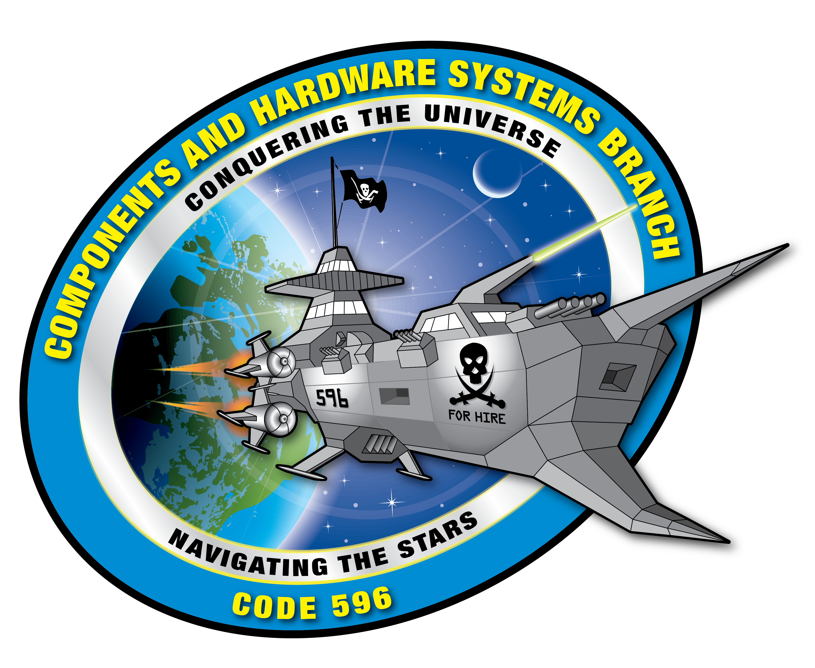
cFS Cryptography Library
Aman Thanvi (GSFC-5960)
Summer 2021
Mentor: John Lucas

Slide 2
Acknowledgements
It has been an honor and privilege to be a summer intern with the GTOSat team.
I would like to convey a special thanks to my mentor John Lucas for his mentorship throughout this summer.

Slide 3
Presentation Background
The objective of this project was to provide a software-only solution using the latest CCSDS Space Data Link Security Protocol – Extended Procedures (SLDS-EP) to secure communications between a spacecraft running the core Flight System (cFS) and a ground station.
The focus of this session’s efforts was to streamline and refine the CryptoLib platform, bringing it closer to a mission-operational state ahead of its first major application with the launch of the Geostationary Transfer Orbit Satellite (GTOSat).
Throughout the development process, new builds were tested and verified using a virtualized environment running the NASA Operational Simulation for Small Satellites (NOS³) and COSMOS Ground Station.

Slide 4


Presentation Background
What is NOS³?
NOS³ is an open-source, software-only testbed for small satellites licensed under the NASA Open-Source Agreement.
It is a collection of Linux executables and libraries.
It is intended to easily interface with flight software developed using the NASA Core Flight Software (cFS).
Current simulations are based on commercial-off-the-shelf (COTS) hardware that is being used on the Simulation-to-Flight 1 (STF-1) CubeSat.
What is COSMOS?
COSMOS is an open-source ground system software which is used to provide command and control of the flight software.
COSMOS is comprised of 17+ applications, that allow control of hardware that can be anything from test equipment (power supplies, oscilloscopes, switched power strips, UPS devices, etc.), to development boards, to instruments and complete satellites.
COSMOS can be easily setup and configured on Windows, Linux, and Mac OSX operating systems, allowing for greatly reduced project costs.
It uses unique telemetry presentations to provide detailed displays and on-demand information.
All data that passes through COSMOS is logged allowing for spacecraft health assessments, post-test analysis, anomaly investigation, and data archiving.

Slide 5
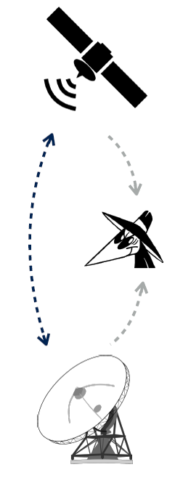
Why CryptoLib for Security?
CryptoLib provides a software-only, fully compliant solution that can plug-and-play with the standard flight and ground software mission architecture while also upholding three fundamental pillars of security:
- Confidentiality
- Integrity
- Availability
Shifting to a platform like CryptoLib allows projects to adapt to increasing demands for communications security rapidly and cost-effectively; easily accessible, preexisting mission resources, like processing power, can be traded in exchange for operation on the CryptoLib platform within full compliance with NASA PRs and STDs.
Generally, a mission’s approach to comply with communication security requirements from applicable NASA Procedural Requirements (NPR) and/or Standards (NASA-STD-XXX), is driven by hardware-based solutions that need design and implementation efforts from early phases and sometimes require coordination with external agencies (e.g., NSA).
Also, the current hardware-based security platforms are expensive and non-modular, imposing challenges to seamless integration into pre-existing mission platforms and architecture.

Slide 6
CryptoLib Overview – Initial Baseline
Ground Station
Spacecraft
Ground Station Software
cFS CryptoLib
cFS CryptoLib
Software Bus
App 1
Apply Security
CI
Process Security
App 2
Process Security
TO
Apply Security
…
App N
Tables
Tables

Slide 7
CryptoLib Overview - Verified baseline
Ground Station
Spacecraft
Ground Station Software
cFS CryptoLib
cFS CryptoLib
Software Bus
App 1
UDP 5010
Apply Security
CI
Process Security
App 2
Process Security
TO
Apply Security
…
UDP 5011
App N
Tables
Tables
Notes:
This diagram represents CryptoLib after the baseline functionalities were verified and documented. All sublayers here were present and functional. However, they were not mission-operational.

Slide 8
CryptoLib Overview – Current functionality
Ground Station
Spacecraft
Ground Station Software
cFS CryptoLib
cFS CryptoLib
Software Bus
App 1
UDP 5010
Apply Security
CI
Process Security
App 2
Process Security
TO
Apply Security
…
UDP 5011
App N
Tables
Tables
Notes:
This diagram represents the achieved and verified the functionality of CryptoLib in this session; its initial codebase was significantly restructured to satisfy target functionality and requirements and mission-readiness guidelines while maintaining compliance with NASA-STD-1006. Most notably, the Command Ingest (CI) and Telemetry Output (TO) functionalities were restructured entirely, while the Spacecraft ‘Process Security’ (TC_Process) and ‘Apply Security’ (TC_Apply) functionalities are in the process of being re-prototyped.

Slide 9
Presentation Methodology - Input
Started with a functional, but not mission-operational, build of CryptoLib. All basic functionalities were demonstrated and verified through test scripts simulating different flight conditions and operations.
However, the existing codebase required refactoring to reach a more modular and polished structure to move toward a more mission-ready state.

Slide 10
Presentation Methodology - Process
The Command Ingest (CI) and Telemetry Output (TO) applications were restructured first.
Large functional blocks were split into smaller, more manageable files that were all connected under dynamic header files.
Outdated standards and cipher integrations were removed and staged for replacement with newer cryptographies.
After restructuring these applications, a new functional baseline was established and verified before continuing with the refactor process.
Next were the ‘Apply Security’ and ‘Process Security’ sublayers.
These modules proved to be the most intensive and time-consuming to restructure, as they make up a large portion of CryptoLib’s active functionality and have the most dynamic modules.

Slide 11
Presentation Methodology - Outcome
CryptoLib’s initial codebase was significantly restructured to satisfy target functionality and requirements and mission-readiness guidelines while maintaining compliance with NASA-STD-1006.
The Command Ingest (CI) and Telemetry Output (TO) functionalities were restructured entirely, while the Spacecraft ‘Process Security’ (TC_Process) and ‘Apply Security’ (TC_Apply) functionalities are in the process of being re-prototyped.

Slide 12
Continuing Development of CryptoLib
Complete the re-prototyping of the Spacecraft ‘Process Security’ (TC_Process) and ‘Apply Security’ (TC_Apply) functionalities.
Update the ‘Tables’ on both the Ground Station and Spacecraft sides of the architecture to leverage and integrate more modern standards and technologies.

Slide 13
Presentation Results and Conclusions
CryptoLib’s current state puts it on track to be fully operational prior to GTOSat’s launch readiness milestones.
CryptoLib has proven to be a modular software-only solution for missions to be compliant with applicable communication security requirements.
Update the Ground Station layer to match Spacecraft layer updates to ensure seamless operation across a more modern software-only platform.

Slide 14

Future Plans
Receive a Bachelor’s degree in Computer Science with a cybersecurity focus and a minor in Cybersecurity at the University of Maryland, College Park.
Pursue additional security intern and research opportunities within the space communication and mission domain.
Explore further computer science opportunities in the public and private sectors.
Pursue a Master’s degree in Computer Science

Slide 15
References
References
Asbury, M. (2017, August 22). NASA operational simulation for small satellites. NASA. https://www.nasa.gov/centers/ivv/jstar/nos3.html.
Cosmos. Aerospace. (n.d.). https://www.ball.com/aerospace/programs/cosmos.
Nos3. (n.d.). http://www.stf1.com/NOS3Website/Nos3MainTab.php.

Slide 16
Questions?

